Slide 1
Keep your eyes open!
Tram in traffic
Notes:
Stay safe
Watch out

Slide 2
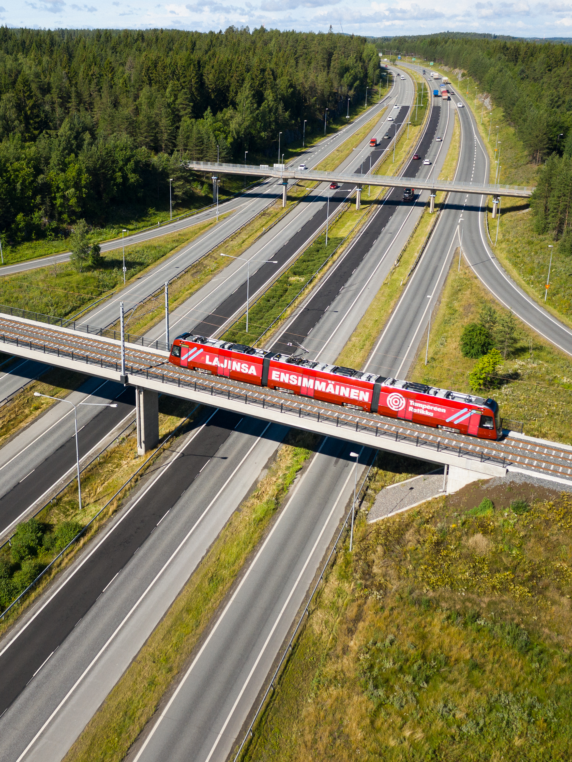
Tampere Tramway
The Tampere Tram is brand new and it will be manufactured in Kajaani, Finland
The first tram came to Tampere in May 2020
There will be a total of 19 new trams in traffic in Tampere
One Tampere Tram can carry 264 passengers
You can travel by tram and by bus using the same ticket
You can start traveling by tram on 9 August 2021.

Slide 3
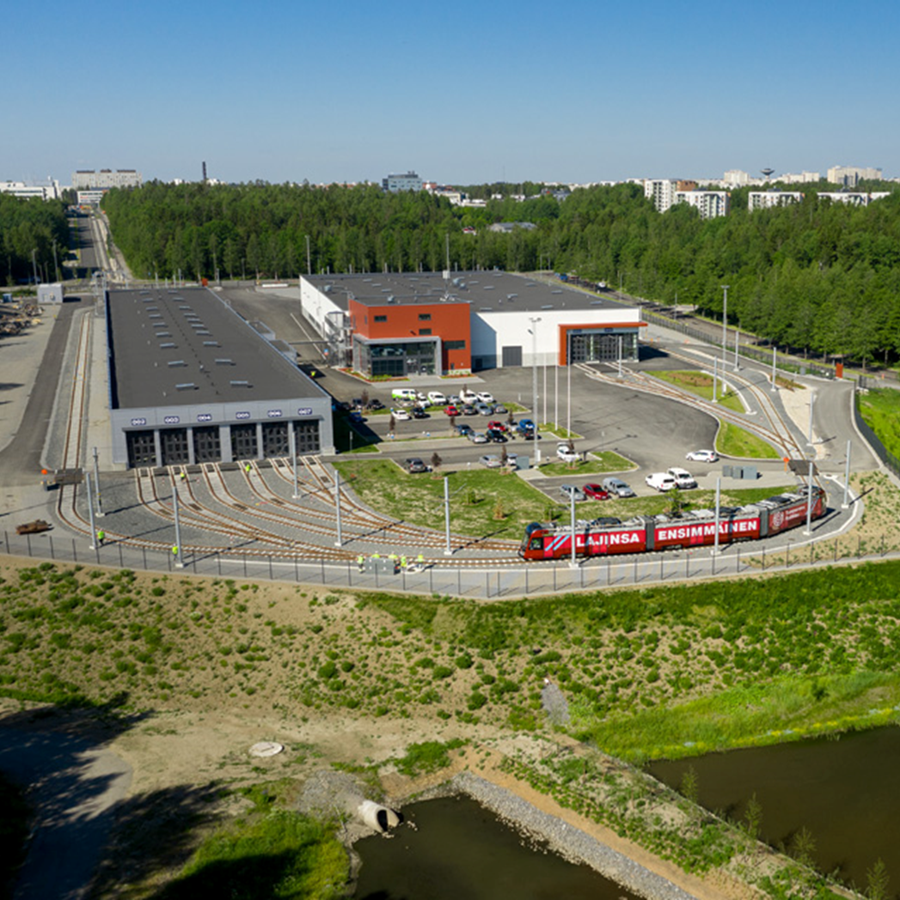
Test runs will start at the depot
The depot is a place where the trams are stored and serviced. It is the trams’ home.
The depot is located in Hervanta
All trams will first perform test runs at the depot
Once the functioning of the tram has been tested, the tests will be extended to the test run route outside of the depot
The tram depot in Hervanta is the home of all tram cars!

Slide 4
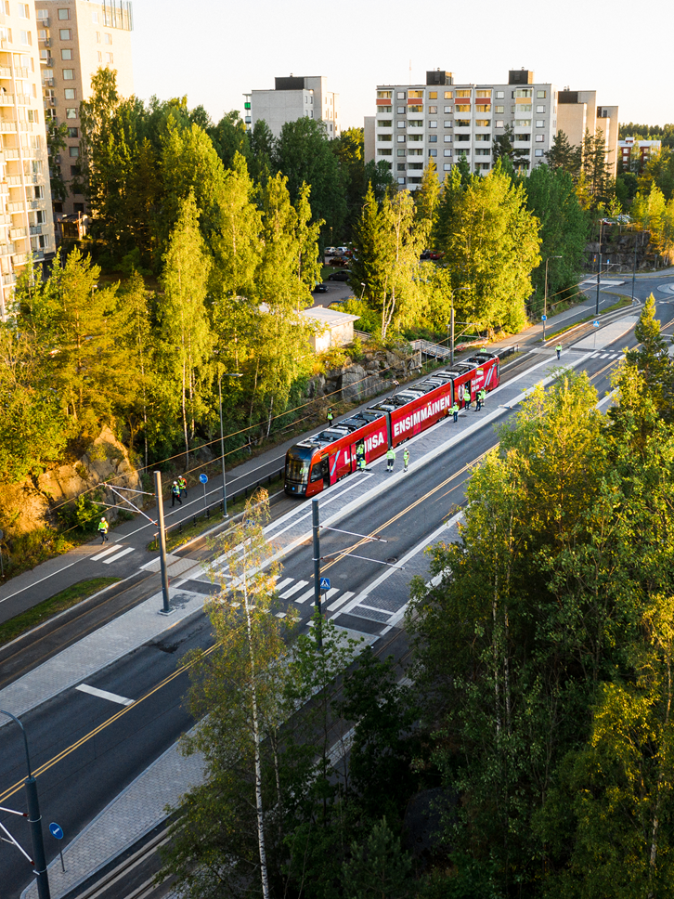
Test runs will reach Tammela area
in September
Test runs began on a route between the tram depot and Turtola in March
The test runs area will expand between Turtola and Tammela on September 14 (week 38)
Test runs will end September 18
Test runs are carried out on weekdays between 9 and 15 o’clock
Test runs are done 14.-18.9.2020 between Hervanta and Tammela area

Slide 5
Test run route 1
Test run area will be commissioned in March 2020
The test runs are performed on a route between Hervanta and Turtola
Sometimes the tram moves at walking speed, sometimes as fast as other vehicles
The tram is first tested at the depot.
Can you find the start and end point of the test run route on the map?

Slide 6
Test run route 2
Can you find your school on the map?
Test run area will be commissioned in September 2020
The test truns are performed on a route between Hervannan valtaväylä (beginning from Turtola), Rieväkatu, Sammonkatu, Itsenäisyydenkatu to the railway tunnel and Teiskontie to Kaupinkatu
Sometimes the tram moves at walking speed, sometimes as fast as other vehicles
Can you find the start and end point of the test run route on the map?

Slide 7
How do you know if you are along the test run route?

Slide 8
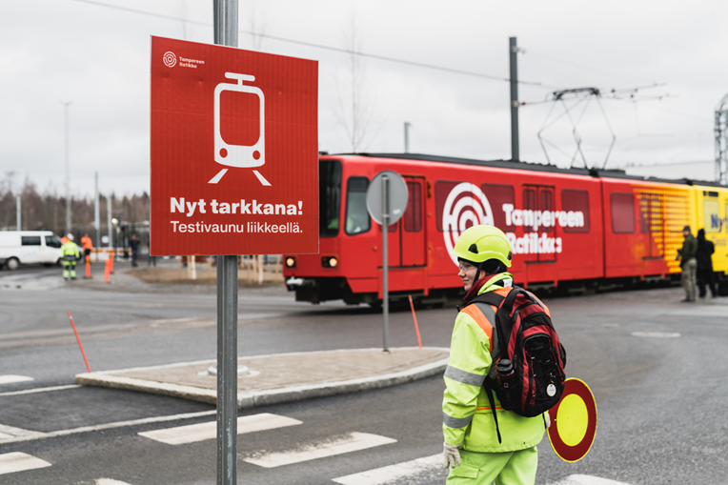
Traffic signallers guide road users
Traffic signallers guide all road users during test runs
Always follow the guidance of the traffic signaller
Signs will be put up along the new test run area to indicate that the tram is on the move
When a new test run area is put into operation, signs will be put up in the area

Slide 9
How to cross the tramway safely?

Slide 10
Crossing the tramway safely
Always cross the tramway only at pedestrian crossings or designated crossovers
BEFORE CROSSING, REMEMBER: Stop – look – listen – look – walk!
Remember that the track is not a place for playing or hanging about
Never take photos or selfies on the track
Always follow the guidance of the traffic signaller

Slide 11
Remember!
The tram can’t swerve around you, because it runs on tracks
The tram is silent, so you don’t necessarily hear it in advance
A tram weighs about the same as ten elephants! That amount of steel is very slow to stop even when slamming on the brakes
In addition to trams, there is also maintenance vehicles moving on the track, so always be careful when crossing the track!

Slide 12
Thank you!
Let’s stay safe in traffic together!

Slide 13
Useful links and videos for teachers
Tampere Tramway traffic safety site
https://www.tampereenratikka.fi/en/traffic-safety/
Traveling by tram and bus:
Rasse the dog travels by Tampere Tram (in Finnish): https://youtu.be/9z7BL0wucCM
Onni the bear travels by Nysse bus (in Finnish): https://youtu.be/zBGXAqfLbWY Traffic safety:
Crossing the tramway tracks (in Finnish): https://www.youtube.com/watch?v=uTy9J3WRBjU
Track safety:
A video by the Finnish Transport Infrastructure Agency on track safety for secondary school children (in Finnish): https://youtu.be/p2UCXwtRBzs

