Slide 1
Keep your eyes open!
Tram in traffic
Notes:
Stay safe
Watch out

Slide 2
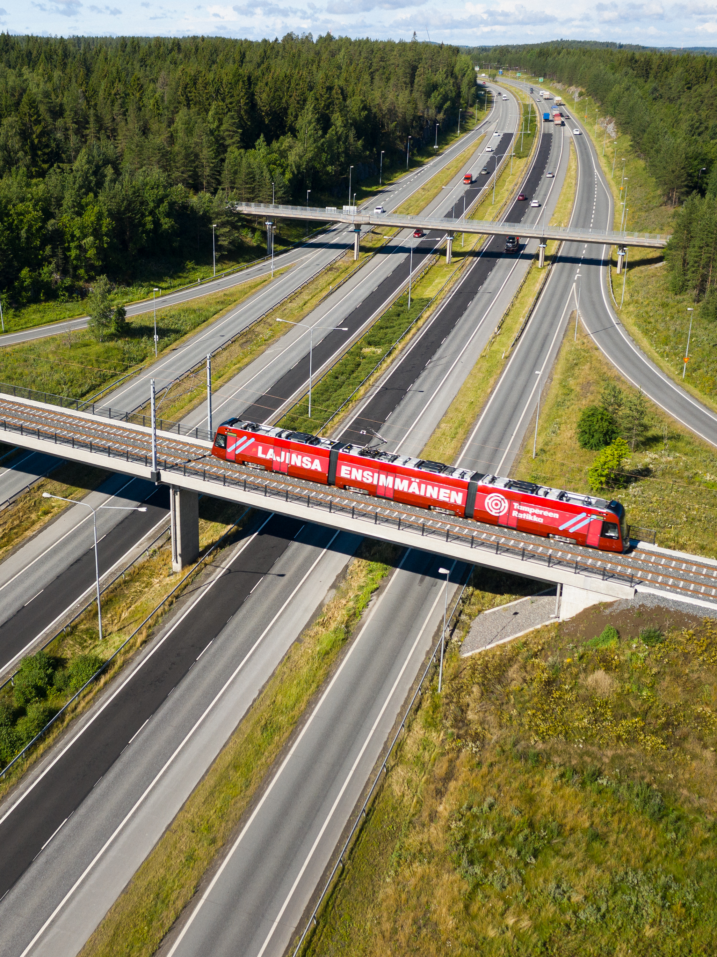
Tampere Tramway
The Tampere Tram is brand new, and it will be manufactured in Kajaani, Finland
The first tram was delivered to Tampere in May 2020
There will be a total of 19 new trams in the Tampere traffic
One Tampere Tram can carry 264 passengers
You can travel by tram and by bus using the same ticket
You can start travelling by tram on 9 August 2021.

Slide 3
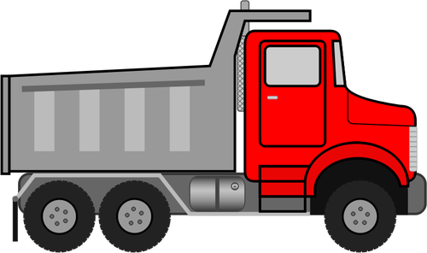
Tampere Tram
Length 16.5 m
Height 4.4 m
Width 2.6 m
Maximum total mass 48 t
16.5 m
Length 37.3 m
Height 3.60 m
Width 2.65 m
Total mass 57.4 t
Maximum total mass 84.4 t (104 sitting + 6 people/m²)
37 m

Slide 4
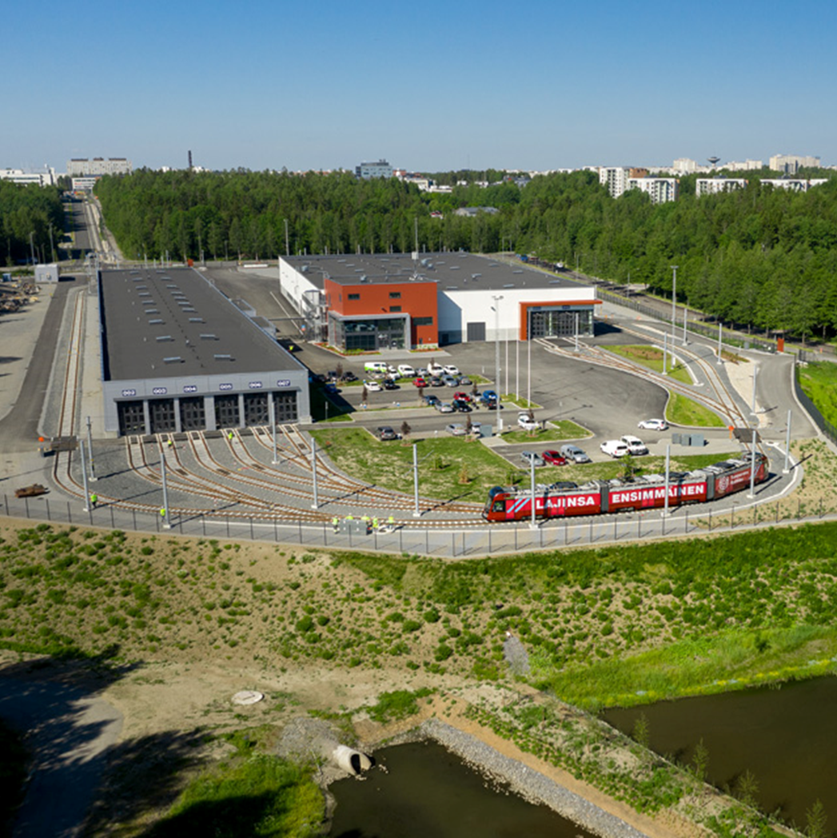
Test runs will start at the depot
The depot is where the trams are based and serviced. It is the trams home
The depot is in Hervanta
All trams will first perform test runs at the depot
Once the functioning of the tram has been tested, the tests will be extended to the test run route outside the depot
The tram depot in Hervanta is the home of all trams!

Slide 5
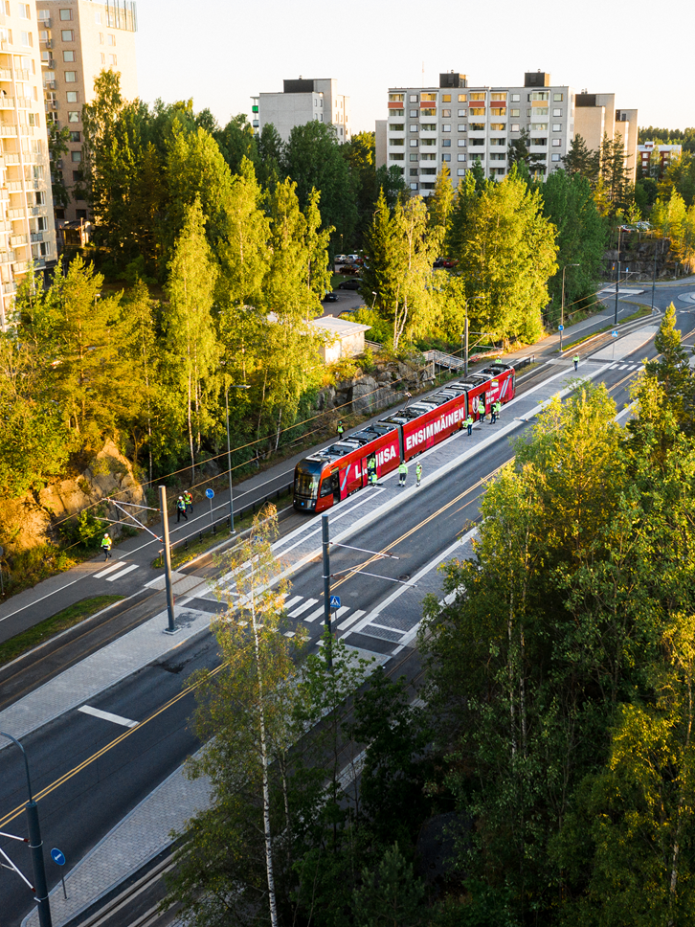
About test runs
Test runs began on a route between the tram depot and Turtola in March 2020
The test run area expanded between Itsenäisyydenkatu railway tunnel and Pyynikintori in November 2020
In March 2021, the test runs will expand to Kaleva area (Teiskontie – Lääkärintie) and South-Hervanta area (Insinöörinkatu – Makkarajärvenkatu)
Test runs are done during the hours of daylight (around 09.00-15.00)
Test runs will continue regularly, and several trams will appear in the streetscape.
Spot the tram on a test run!

Slide 6
Test run route 1
The test run area was commissioned in March 2020
The test runs are performed on a route between Hervanta and Turtola
Sometimes the tram moves at walking speed, sometimes as fast as other vehicles
In addition to trams, maintenance vehicles also move on the track, so always be careful when crossing the track!
The tram is first tested at the depot.
Can you find the start and end points of the test run route on the map?

Slide 7
Test run route 2
The test run area was commissioned in September 2020
The test runs are performed on a route between Hervannan valtaväylä (beginning of Turtola), Rieväkatu, Sammonkatu, Itsenäisyydenkatu to the railway tunnel and Teiskontie to Kaupinkatu
Sometimes the tram moves at walking speed, sometimes as fast as other vehicles
In addition to trams, maintenance vehicles also move on the track, so always be careful when crossing the track!
Can you find your school on the map?
Can you find the start and end points of the test run route on the map?

Slide 8
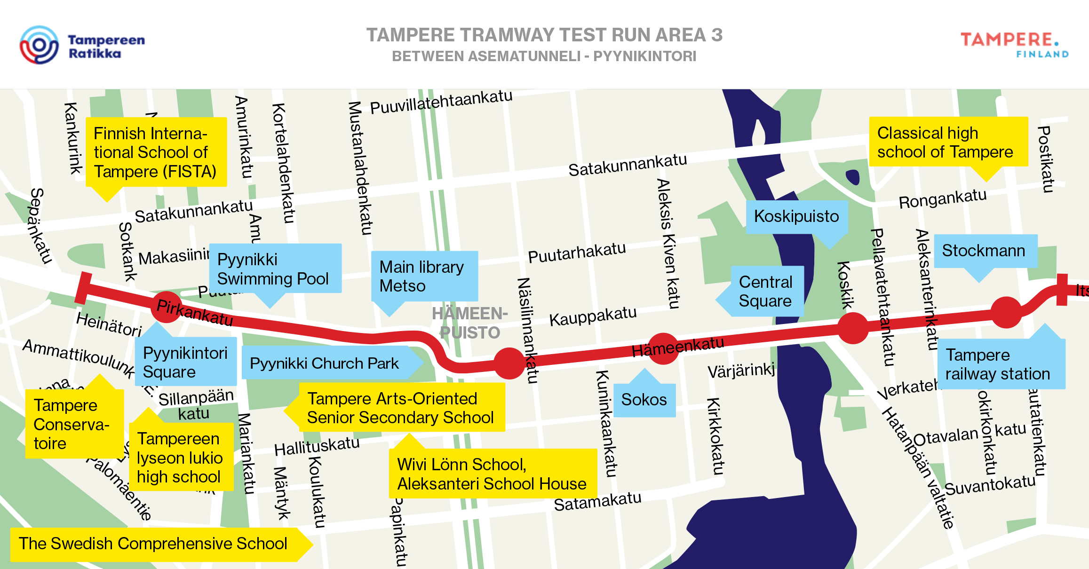
Test run route 3
The test run area was commissioned in November 2020
The test truns will be performed on a route between Itsenäisyydenkatu railway tunnel and Pyynikintori (Hämeenkatu and Pirkankatu)
Sometimes the tram moves at walking speed, sometimes as fast as other vehicles
In addition to trams, maintenance vehicles also move on the track, so always be careful when crossing the track!
You can spot the tram in the city centre! Stay alert when you’re on your way to school.

Slide 9
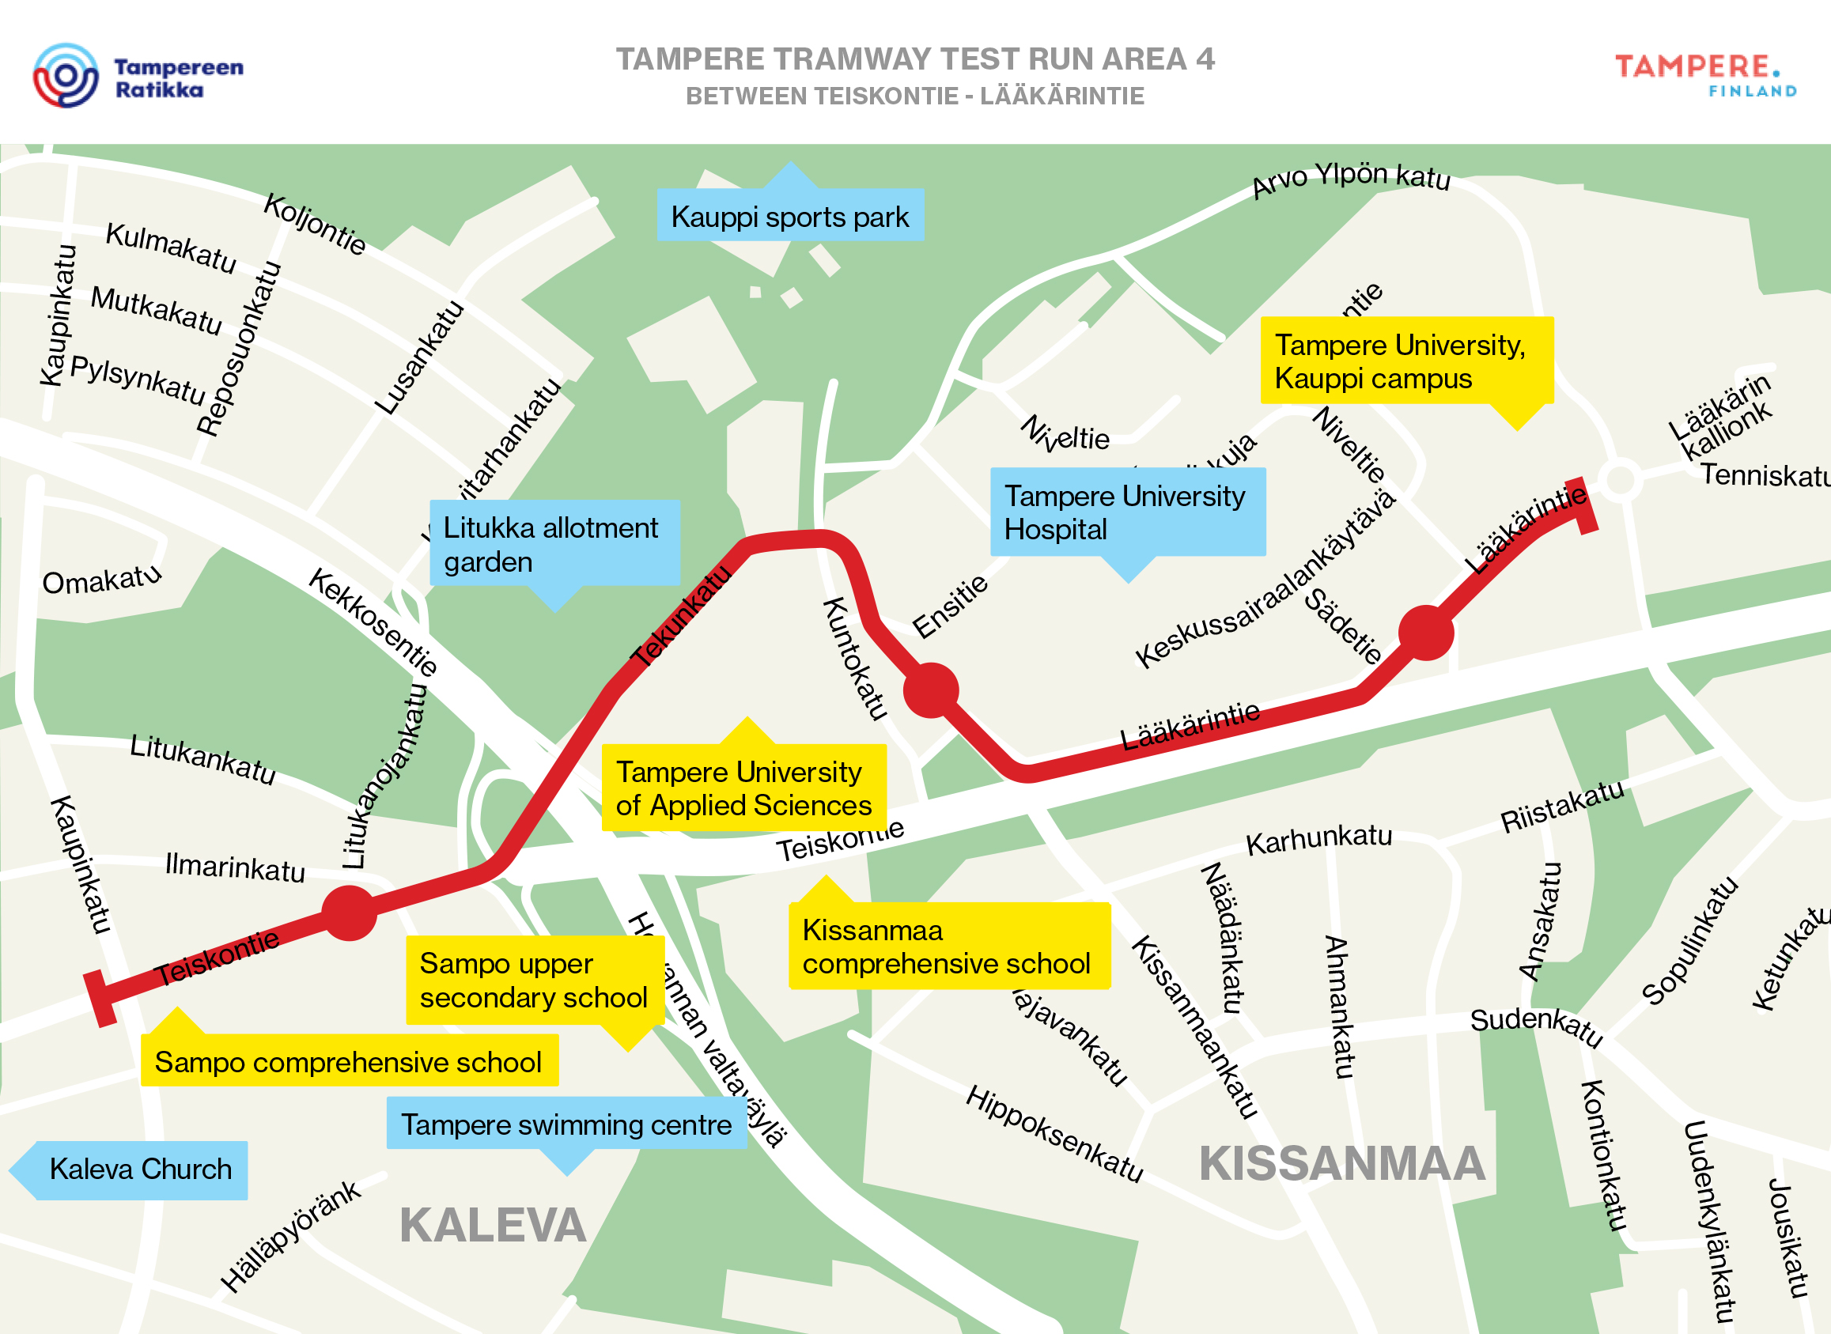
Test run route 4
The test run area will be commissioned in March 2021
The test truns will be performed on a route between Teiskontie, Tekunkatu and Lääkärintie
Sometimes the tram moves at walking speed, sometimes as fast as other vehicles
In addition to trams, maintenance vehicles also move on the track, so always be careful when crossing the track!
Stay alert when you’re on your way to school.

Slide 10
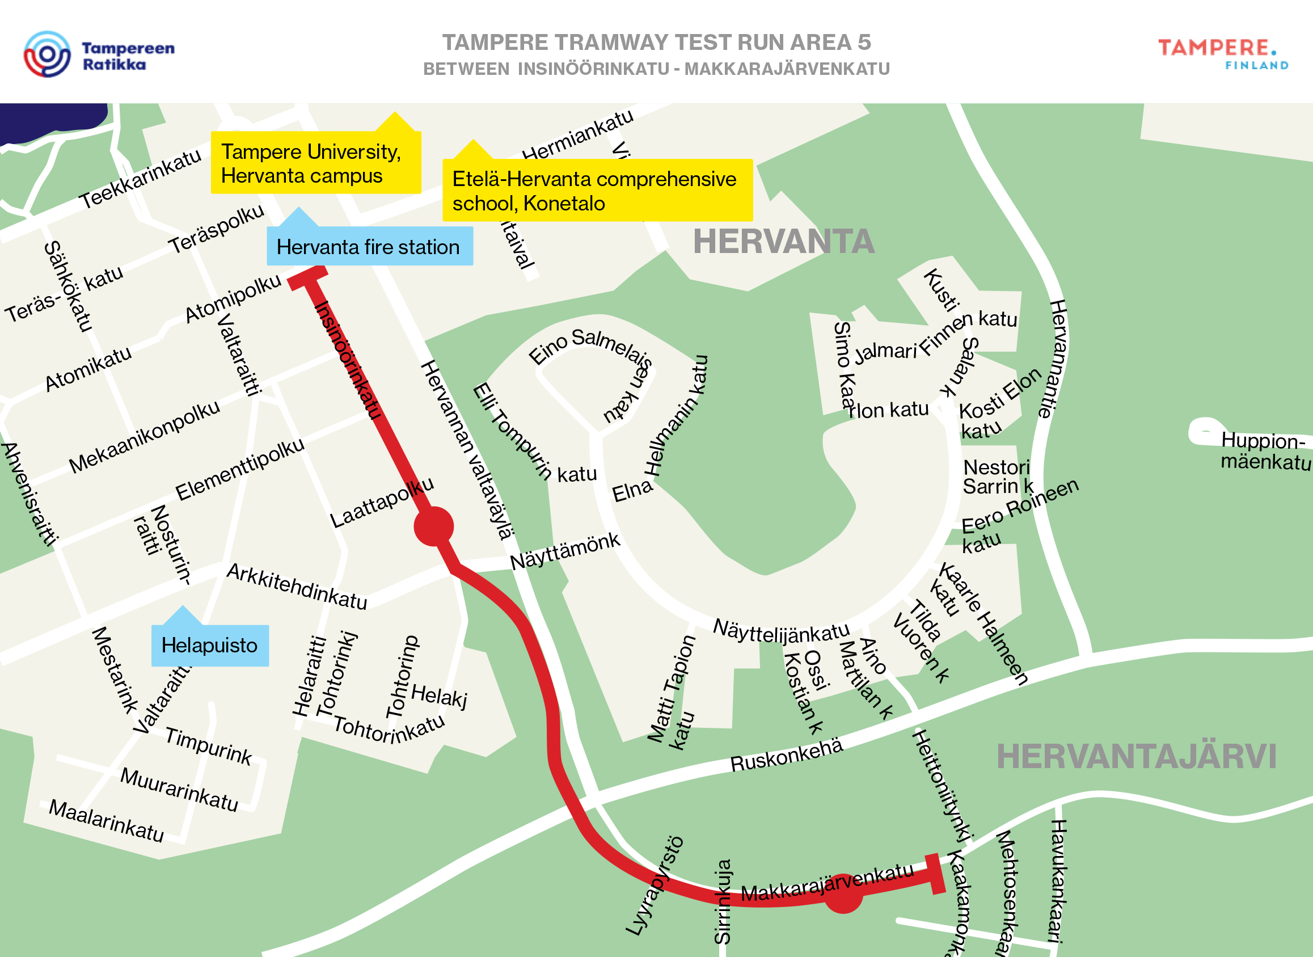
Test run route 5
The test run area will be commissioned in March 2021
The test truns will be performed on a route between Itsenäisyydenkatu railway tunnel and Pyynikintori (Hämeenkatu and Pirkankatu)
Sometimes the tram moves at walking speed, sometimes as fast as other vehicles
In addition to trams, maintenance vehicles also move on the track, so always be careful when crossing the track!
Spot the tram on a test run!

Slide 11
How do you know if you are along the test run route?

Slide 12
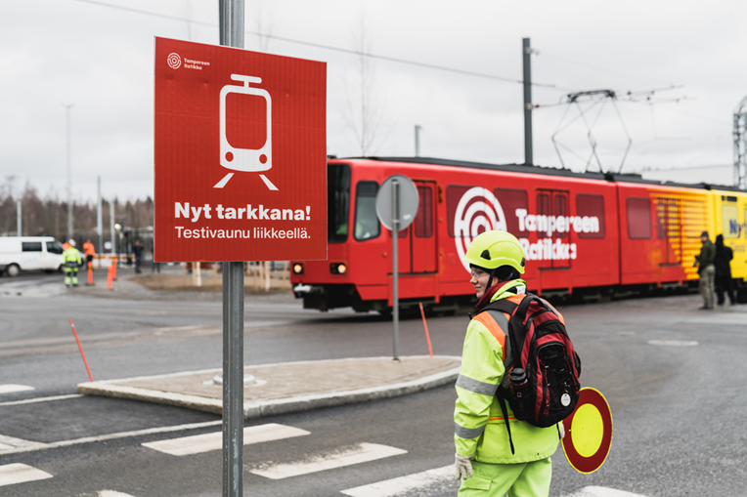
Traffic signallers guide road users
Traffic signallers guide all road users during test runs
Always follow the guidance of the traffic signaller
Signs will be put up along the new test run area to indicate that the tram is on the move
When a new test run area is put in operation, signs will be put up in the area

Slide 13
How do I cross the tramway safely?

Slide 14
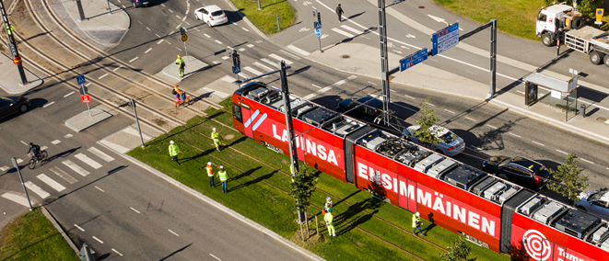
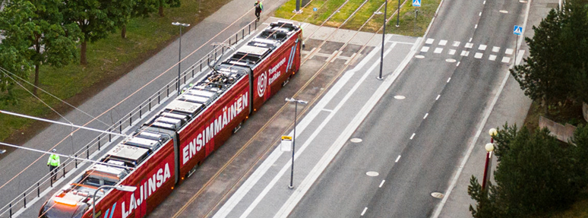
Crossing the tramway safely
Always cross the tramway only at pedestrian crossings or designated crossovers
BEFORE CROSSING, REMEMBER: Stop – look – listen – look – walk!
PEDESTRIAN CROSSINGS
At pedestrian crossings, pavement markings (a zebra crossing) run across the road and track
Usually, there are also traffic lights at a pedestrian crossing
Trams and other vehicles must give way to pedestrians on a zebra crossing
DESIGNATED CROSSOVERS
At designated crossovers, there are no pavement markings running across the road and track
At designated crossovers, pedestrians must give way to trams, buses and other approaching vehicles

Slide 15
Remember!
Remember that the track is not a place for playing or hanging about
Never take photos or selfies on the track
Always follow the guidance of the traffic signaller
The tram can’t swerve around you, because it runs on tracks
The tram is silent, so you don’t necessarily hear it in advance
A tram weighs about the same as ten elephants! That amount of steel is very slow to stop, even when the brakes are slammed on
In addition to trams, maintenance vehicles also move on the track, so always be careful when crossing the track!

Slide 16
Thank you!
Let’s stay safe in traffic together!

Slide 17
Useful links and videos for teachers
Tampere Tramway traffic safety site
https://www.tampereenratikka.fi/en/traffic-safety/
Travelling by tram and bus:
Rasse the dog travels by Tampere Tram (in Finnish): https://youtu.be/9z7BL0wucCM
Onni the bear travels by Nysse bus (in Finnish): https://youtu.be/zBGXAqfLbWY Traffic safety:
Crossing the tramway tracks (in Finnish): https://www.youtube.com/watch?v=uTy9J3WRBjU
Track safety:
A video by the Finnish Transport Infrastructure Agency on track safety for secondary school children (in Finnish): https://youtu.be/p2UCXwtRBzs

